Slide 1

Saint Conor's College
Exam Information for candidates, parents and guardians

Slide 2
JCQ
JOINT COUNCIL FOR QUALIFICATIONS
JCQ provides a single voice on issues of examination administration including rules and regulations which pupils must adhere to when undertaking all external qualifications.
These qualifications include GCSEs, A levels, BTECs and vocational qualifications.
St Conor’s College enters pupils for examinations with the following Awarding Bodies
AQA
CCEA
OCN
OCR
WJEC
Pearson – Edexcel and BTEC

Slide 3
Information for Candidates – JCQ Written examinations
Information for Candidates – JCQ On-screen tests
Information for Candidates – JCQ Coursework assessments
Information for Candidates – JCQ Non-examination assessments
Information for candidates – CCEA GCSE Controlled assessments
Information for Candidates – JCQ Information Privacy Policy
Information for Candidates – JCQ Social Media
Information for Candidates - AI
JCQ Warning to Candidates notice
JCQ NO MOBILE PHONES, NO WATCHES - This notice is also placed outside each exam room to remind students of the regulations for unauthorised items.
CCEA Preventing Malpractice in Examinations and Assessments – pupil guide
CCEA Preventing Malpractice in Examinations and Assessments – parent guide
JCQ – On your exam day checklist
St Conor’s Exam Overview Powerpoint
Preparing to sit your exam CCEA Booklet
St Conor’s Wellbeing Tips – Tips on how to look after yourself during exam season
EXAM INFORMATION
The following DOCUMENTS will be posted on the SCHOOL website.
All Candidates/Parents are requested to read these documents and adhere to the rules and regulations.

Slide 4

PRE-EXAMS
All pupils who have been entered for the November modules should have received a statement of entry which they were asked to sign and return to form teachers.
Pupils will now be issued with their exam timetable for the November series.
Any concerns about it then please see Mrs McCallion.

Slide 5
PRE-EXAMS
ACCESS ARRANGEMENTS
These are pre-examination adjustments for candidates based on evidence of need and their normal way of working throughout the school year.

Slide 6
SPECIAL CONSIDERATION
This will be applied for where a candidate is considered to be disadvantaged during their exam/series due to illness, bereavement, medical conditions, including post surgery procedures. In many of these circumstances the school will require medical information to support the application.

Slide 7

BEFORE AN EXAM
Please arrange to attend any exam approximately 15 - 30 mins before it is due to begin.
Check the exam notice board for any changes to venues when you arrive each day.
The school timetable is available on our school website in the exams area.

Slide 8

EQUIPMENT FOR AN EXAM
You should have all equipment you need for an exam with you
  including, 2 black pens, pencil, ruler, rubber, sharpener, calculator, protractor etc.
  This equipment should be placed in a clear pencil case.
  Note: It is not the school or teachers responsibility to supply you with these items.
Do not use anything other than a black biro pen in your exam. Correcting pens, tippex, highlighters, gel pens cannot be used on your exam paper.
You may only use a calculator when advised to do so.
Any water bottles should be clear and have no labels.

Slide 9

ENTERING THE EXAM VENUE
On entering the venue sit at your allocated seat. There will be a card with your name on the desk.
Mobile phones should be switched off and placed on the floor beside your desk. (Don’t forget to take it with you when you are leaving).
All watches, including smart watches must be placed in the invigilators tray.

Slide 10

ENTERING THE EXAM VENUE
You must not talk to, attempt to distract or communicate with other candidates once you have entered the examination room.
You must follow the instructions of the invigilator
You must not sit an examination in the name of another candidate
You must not become involved in any unfair or dishonest practice during an examination.
If you are confused about anything, speak to an invigilator.

Slide 11


ENTERING THE EXAM VENUE
Possession of anything unauthorized in an exam venue is considered malpractice
If you are found to have any unauthorized equipment or materials with you then this will lead to a full inquiry by the awarding body where you will be subject to penalties and possible disqualification of your exam.
No digital devices, no ear plugs, no class notes, no school bags should be brought into the exam venue. This is considered malpractice.

Slide 12
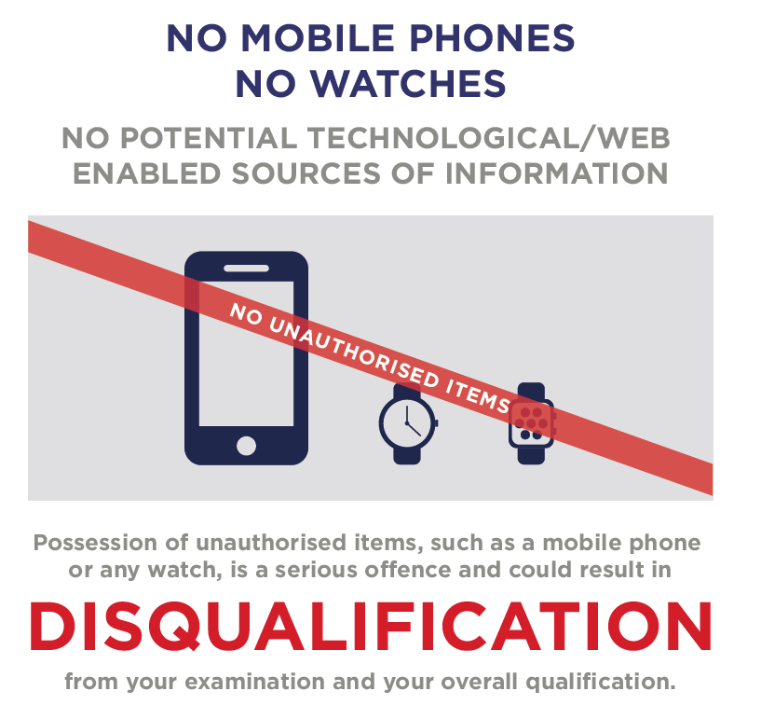

Slide 13

WHAT IS MALPRACTICE?
Malpractice is defined by JCQ as;
“ a serious breach of exam regulations which results in penalties or disqualification.”

Slide 14
EXAMPLES OF MALPRACTICE INCLUDE:
Bringing in your own blank sheets of paper to write on or work out on
Bringing in a calculator or dictionary unless it is allowed
Bringing in any notes of any description or having any stationary which is written on
Bringing in a phone or any electronic device
Any type of disruptive behaviour e.g. moving seats or calling out
Attempting to take scripts out of the centre
Having any inappropriate material in a script e.g. a drawing, doodle or a possibly offensive comment or sarcastic answer

Slide 15
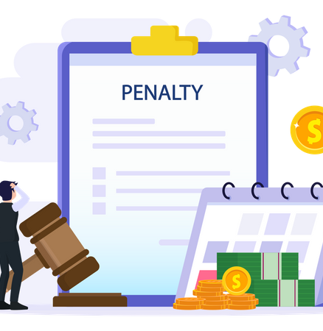
MALPRACTICE AS DEFINED BY JCQ
CAN RESULT IN PENATIES 5 – 9 BEING ISSUED
Penalties 5-9 by JCQ
5 - Disqualify the pupil from that module
6 - Disqualify the pupil from the entire subject
7 - Disqualify the pupil from one or more subjects
8 - Disqualify the pupil from all qualifications – eg GCSE or A Level
9 - Bar the pupil from entering ANY public exams for a set period of time

Slide 16
Invigilators
Always listen to the invigilator.
Follow their instructions at all times.
BUT
It is also your responsibility to make sure you have the correct paper, tier and are given the correct allocated time for your exam, especially if you are entitled to extra time.

Slide 17
SITTING YOUR EXAM
Follow the times given for your exam. Your teacher will have advised you on the timings per question, per paper.
Exam times will be shown clearly in each venue. Extra time will also be shown for those candidates who are entitled to it.
Listen to the Invigilator and follow their instructions at all times
Do not communicate with anyone else in the venue. Do not attempt to borrow anything from anyone else in the venue. If you need assistance put your hand up for the attention of the invigilator.
Candidates are not allowed to leave the exam venue during an exam.

Slide 18

SITTING YOUR EXAM
Tell the invigilator at once if;
  You think you have not been given the correct paper or resources for that paper.
  The question paper is incomplete or badly printed.
  You think the timing of your exam is wrong.
Read the instructions on the front of your question paper carefully and follow these instructions.
Fill in the details carefully on the front of your exam paper and make sure you fill in your details on any additional paper used.

Slide 19
DURING YOUR EXAM
Remember to write your answers in the designated sections of the booklet, including rough work and put your pen through any rough work when finished.
Always put your hand up to speak to the invigilator if you need assistance or have any concerns about your paper.
You must not ask for, and will not be given, any explanation of a question

Slide 20
Candidate Arrives Late for Exam
Report to Reception
Reception to make contact with Exam Officer
Candidate Remains in Reception until seen by Exam Officer
Record taken of time of arrival and why candidate was late
Candidate to be briefed on relevant Exam Rules and Regulations
Candidate Taken to Exam Centre
Candidate is given the full allowed time for the Exam
Less than 1 hour late unless the exam has finished then Invigilator records start and finish times on Exam Board Attendance Record
If Candidate is more than one hour late or they arrive after the end of an exam that is less than one hour(Very Late Arrival) then EO or SLT will complete Very Late Arrival Report via Centre Admin Portal
Notes:
Either way one of the things we need to do to ensure we have a good intake is maximise our results

Slide 21

ASKING OUT DURING AN EXAM
You should not ask to leave the venue during an exam.
If you need to use the toilet or are feeling unwell you must inform the invigilator immediately. An adult will escort you out of the venue and remain with you until you are well enough to return and continue your exam.

Slide 22
AFTER THE EXAM
When the exam is over, place any used supplementary sheets in order into your answer booklet. Do not remove any materials.
Do not leave the venue until told to do so
Leave quietly as there may be other pupils / exams continuing
Take all personal belongings with you, including your mobile phone and/or smart watch.

Slide 23
Saint Conor's College
coursework regulations

Slide 24

AUTHENTICATION - JCQ
When you submit any coursework for marking, you will be asked to
sign an authentication statement confirming that you have read and
followed these regulations.
The regulations state that:
- “the work which you submit for assessment must be your own”
- “you must not copy from someone else or allow another candidate to copy from you”.

Slide 25
REFERENCING – SOURCES - JCQ
If you use the same wording as a published source, you must place quotation marks around the passage and state where it came from.
For material taken from the internet, your reference should show the date when the material was accessed and must show the precise web page, not the search engine used to locate it. This can be copied from the address line.
If you copy the words or ideas of others and do not show your sources in references and a bibliography, this will be considered as cheating.

Slide 26

Coursework – good practice - JCQ
If you receive help and guidance from someone other than your teacher, you must tell your teacher who will then record the nature of the assistance given to you.
Your parent/carer may provide you with access to resource materials and discuss your coursework with you. However, they must not give you direct advice on what should and should not be included.
If you worked as part of a group on an assignment, you must each write up your own account of the assignment. Even if the data you have is the same, the description of how that data was obtained and the conclusions you draw from it should be in your own words.

Slide 27

plagiarism- JCQ
Plagiarism involves taking someone else’s words, thoughts or ideas and trying to pass them off as your own.
It is a form of cheating which is taken very seriously.

Slide 28
PLAGARISM- JCQ
Don’t think you won’t be caught!!
Markers can spot changes in the style of writing and use of language. Markers are highly experienced subject specialists who are familiar with work on the topic concerned. They may even have r4ead the source you are using (or even marked the essay you have copied from!!)
Internet search engines and specialised computer software can be used to match phrases or pieces of text with original.

Slide 29
USE OF AI
AI misuse is taking something made by AI and claim it as your own work e.g. from ChatGPT
Your teachers will tell you if you are allowed to use AI as it depends on the qualification
If you are allowed to use AI you must reference it appropriately by naming the AI tool and stating when you generated the content and how you used it. You should screenshot the questions you asked AI and the response you were given

Slide 30

USE OF AI

Slide 31
MALPRACTICE JCQ
Candidate malpractice’ means:
collusion: working collaboratively with other candidates, beyond what is permitted;
copying from another candidate (including the use of technology to aid the copying);
allowing work to be copied.

Slide 32
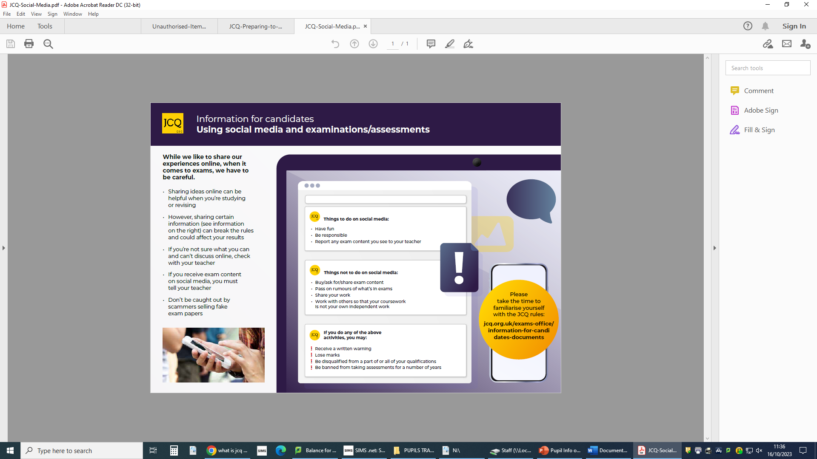

Slide 33
PENALTIES FOR BREAKING REGULATIONS - JCQ
If your work is submitted and it is discovered that you have broken the regulations, one of the following penalties will be applied:
- the piece of work will be awarded zero marks;
- you will be disqualified from that unit for that examination series;
- you will be disqualified from the whole subject for that examination series;
- you will be disqualified from all subjects and barred from entering again for a period of time.
REMEMBER - IT’S YOUR QUALIFICATION SO IT NEEDS TO BE YOUR OWN WORK

Slide 34

This power point is available to download from our school website.
Good Luck Everyone!!

